Slide 1
Grab Bag
IMM 120 – November 19th, 2018

Slide 2
Grab Bag
Final Project
What languages are out there?
Networking / How to make a server
HTML / CSS
Animation
Buttons and Sliders
Platforming Physics

Slide 3
Final Project
Your own creation like the midterm projects
You may extend and improve your midterm
Use loops / arrays
Feel free to use any p5.js library, especially for inspiration.
Josh Fishburn (professor) is familiar with p5.play if you have questions.

Slide 4
Final Project Schedule
Nov 26 (Next Week) – Idea Pitching and Prototyping
December 3 – Working Lab / instruction on common topics
December 10 – Reading Day
December 17 – Final Exam Period
Attendance is not required
Final Lab where you can ask final questions
I’ll be here either way. If everyone’s done, we’ll eat donuts and play games
December 19 – Final Projects Due

Slide 5
Project Showcase
November 30th
Showcase of what goes on in every class.
Please let me know if you’d like to present / have your project showcased.
Criteria:
Your comfort
I’ll work with you
“What can I accomplish with what I learn in IMM120?”
Available.
Let me know ASAP so we can get you space.

Slide 6
Most Popular Programming Languages
https://githut.info/
JavaScript – Browser interactivity, front-end frameworks (React, Angular), server (node.js), scripting
Java – Device programming, Android apps, Minecraft
Python – Easy to learn, lots of libraries, data analysis, scripting
CSS – Styling HTML
PHP – Back-end/server programming, easy to learn
C/C++/Shell – “Low-level” programming, efficient, AI, corporate, high-performance applications
C# - Unity game development, Xbox game development
Objective-C/Swift – iPhone and iOS development

Slide 7
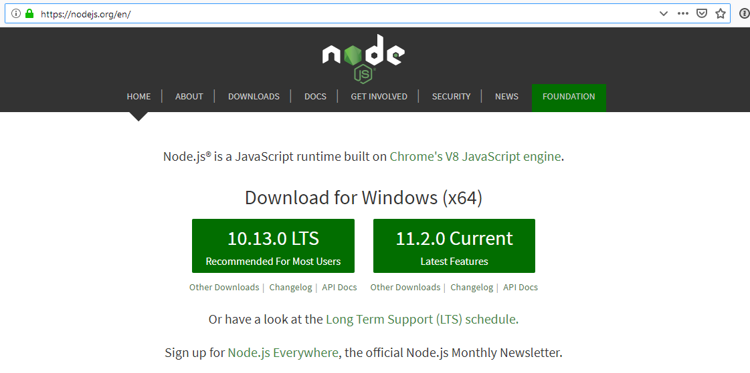
Run Your Own Server
Notes:
To run the server I made, you need node.js. If you want to have a server of your own, Digital Ocean is a great place to rent one, that’s where I get mine.

Slide 8
Rent a Server
I use Digital Ocean (charged by the hour, $5 per month)
AWS offers a free server for a while (then $5 month)
You can turn an old desktop into a server
Ubuntu Server
Command line cheatsheet: “git tower cheat sheet”

Slide 9
HTML / CSS (Markup Languages)
Mozilla Developers Network (MDN)
caniuse.com is a great resource for the latest tech
Style frameworks
Bootstrap / Framework / Pure.css
Tailwinds (CSS utility)
Javascript HTML-replacement frameworks
React
Angular
Ember
Code styling and formatting: http://codeguide.co/

Slide 10
HTML (index.html)
<tag>content</tag>
<opening></closing>
“block” – new line break
“inline” – no break
<div> - division block
<span> - division inline
<p> - paragraph
<b/i/u> - text formatting
<a href=“”> - link
<html>
<head>
<!- loaded assets ->
<link href=“style.css”/>
<script></script>
</head>
<body>
<!– visible content ->
</body>
</html>

Slide 11
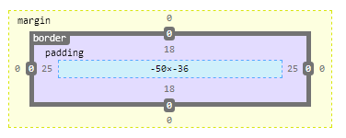
CSS (style.css)
Selectors
Rules
body {
/* rules */
}
.class {
/* <a class=“link”> */
}
#id {
/* <div id=“content”> */
}
.btn.blue {
/* more specific */
}
rule: value;
color: rgb(100, 0, 100);
font-size: 1rem;
margin: 3px; padding: 0;
Notes:
Later rules and more specific rules override earlier ones
Right click and inspect

Slide 12
CSS Pre-Processors
SASS / LESS / PostCSS
Add new features:
Nesting
Variables
Color features
Mixins (functions)
More flexible syntax

Slide 13
Animation
You can load and play videos just like images
Example: https://www.crhallberg.com/justwires/sketch.js
Sprite animation is probably what you’re looking for
https://tinyurl.com/imm120llama
(hold a key to animate)

Slide 14
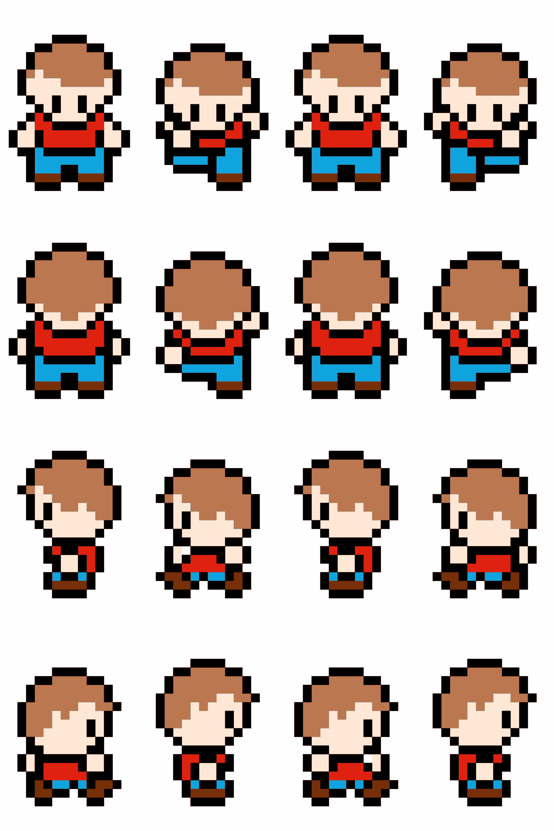
Sprite Sheets
Hold all of the animations of an object in one image
Saves on loading time
Easier to edit and correct
Piskel is an online tool to make these

Slide 15
Sprite Sheets
Each square is a single frame of animation.
We give image() four more numbers to pull out only this rectangle of pixels:
image(
imgVariable,
drawingX, drawingY, drawingWidth, drawingHeight,
sourceX, sourceY, sourceWidth, sourceHeight
);

Slide 16
Sprite Sheets
Each square is a single frame of animation.
By moving this source rectangle, we create the animation and the illusion of movement.
image(
imgVariable,
drawingX, drawingY, drawingWidth, drawingHeight,
sourceX, sourceY, sourceWidth, sourceHeight
);

Slide 17
Sprite Sheets
Each square is a single frame of animation.
Switching from row to row changes the animation, from walking left to walking right, for example.
image(
imgVariable,
drawingX, drawingY, drawingWidth, drawingHeight,
sourceX, sourceY, sourceWidth, sourceHeight
);

Slide 18
How to Add a Button
rect()
mousePressed()
if (pointRect()) {
// do something
// change mode
// change variables
}
draw()
if (pointRect()) {
// hover effect
}

Slide 19
Buttons and Sliders (p5.dom.js)
DOM = Document Object Model
A code model of HTML elements and their styles
Lets you create actual HTML elements
p5js.org > Libraries > p5.dom.js (first one)
https://p5js.org/reference/#/libraries/p5.dom

Slide 20
Platforming Physics
This is only one way to do it.
I find it to be the simplest based on what we’ve learned.
Uses line-to-line collision.
We’ll start with a controls example
https://editor.p5js.org/crhallberg/sketches

Slide 21
1. The Physics
Speed is change in Position
Acceleration is change in Speed
Position += Speed
Speed += Acceleration
Gravity is acceleration
var gravity = 0.3;

Slide 22
2. Vertical Movement
Do we have full control of moving up and down?
Do we want to add gravity when we’re on the ground?
What happens when we jump?
Notes:
Remove DOWN_ARROW controls
Add .inAir boolean

Slide 23
3. Player Origin

Slide 24
3. Player Origin

Slide 25
3. Player Origin

Slide 26
3. Player Origin (Fixed)

Slide 27
3. Player Origin (Fixed)

Slide 28
4. Landing on a Platform

Slide 29
4. Landing on a Platform

Slide 30
5. Falling off a platform
Notes:
Set a fallLeft and fallRight

Slide 31
6. Platform Sides (optional)

Slide 32
7. Camera Tracking (optional)
Easiest way: use translate
// Pin player to center
translate(width/2 - player.x, height/2 - player.y);
If you want something more in-depth, you can give the camera its own position and update it based on the player’s position.
https://tinyurl.com/imm120camera

Slide 33
Minute Surveys
That’s all she wrote!
Any more questions?

